Slide 1

Emergency use of a test article / treatment use of investigational drugs

Slide 2
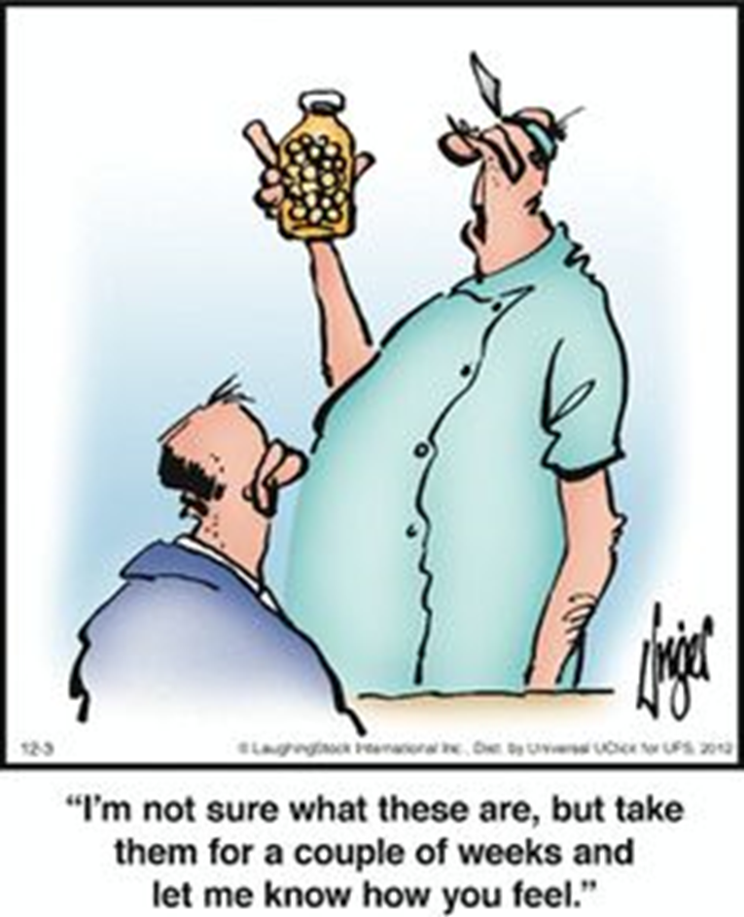

Slide 3
Emergency use is different than
Expanded Access ("compassionate use")
Emergency Use
  Life threatening situation, no other option, not time for IRB approval
  Not research*
  Does not require IRB approval (only notification)
  Requires sponsor and FDA approval
  Requires informed consent
  Only one use
Expanded Access
  Serious disease, no other satisfactory alternative (may be urgent but not emergent)
  Research*
  Requires IRB approval (or IRB chair concurrence)
  Requires sponsor and FDA approval
  Requires informed consent
  Single patient or larger population

Slide 4
Emergency use of a test article
Investigators may be confronted with the need to use a test article in an emergency situation
  In these circumstances review by a full IRB may not be feasible
  FDA regulations allow for an emergency waiver of prior IRB review

Slide 5
Emergency use of a test article
21 CFR 56.102(d)
Life-threatening situation exists requiring treatment with the test article
  likelihood of death or severe debilitation is high unless the course of the disease is interrupted
No standard acceptable treatment is available
Insufficient time is available to obtain IRB approval at a convened meeting
Notes:
This does not require the condition to be immediately life-threatening; rather intervention is required before review by the IRB is feasible

Slide 6
Emergency use of a test article
Emergency use provision in the FDA regulations is an exemption from prior review and approval by the IRB
It is not "emergency IRB approval"
  IRB only acknowledges compliance with FDA regulations at 21 CFR 56.104(c)

Slide 7
Emergency use of a test article
FDA regards emergency use of a test article (other than a medical device) as a "clinical investigation"
  may require data from an emergency use to be reported in a marketing application
However, DHHS states "emergency care may not be claimed as research, nor may the outcome of such care be included in any report of a research activity"
  single case reports may be allowable

Slide 8
Process
Contact IRB Office or Chair prior to use of the test article
  Weekday business hours
    IRBORA@unmc.edu
    (402) 559-6463
  Other times
    bgordon@unmc.edu
    (402) 559-6045
    If no response contact IRB chair on call
      https://net.unmc.edu/rss/rss_irb_chair_schedule.php

Slide 9
Process
Contact IRB Office or Chair prior to use of the test article
Contact:
  Investigational Drug Service (UNMC/NM) or Investigational Pharmacist (CN) if drug or biologic OR IDRC if device
  Sponsor
  FDA

Slide 10
Process
Contact IRB Office or Chair prior to use of the test article
Contact
  Investigational Drug Service (UNMC/NM) or Investigational Pharmacist (CN) if drug or biologic OR IDRC if device
  Sponsor
  FDA
Complete Section I of the Emergency Use Report

Slide 11
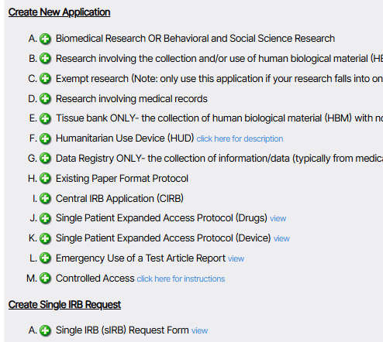
https://net.unmc.edu/rss/rss_irb_edit.php

Slide 12
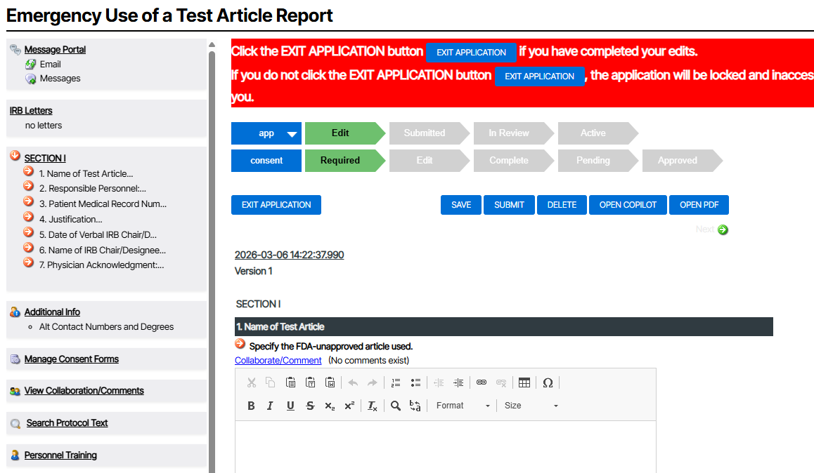

Slide 13
Process
Contact IRB Office or Chair prior to use of the test article
Contact:
  Investigational Drug Service (UNMC/NM)/Investigational Pharmacist (CN) OR IDRC if device
  Sponsor
  FDA
Complete Section I of the Emergency Use Report
Obtain consent

Slide 14
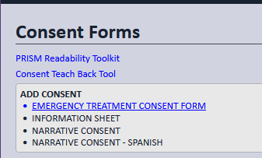
Consent
Consent from the subject or their LAR must be obtained (21 CFR 50.23(a))
Consent form template in RSS

Slide 15
Consent
If it is not feasible to secure the patient’s consent then the treating physician AND an uninvolved physician must certify in writing:
  not feasible to obtain informed consent
  life threatening situation
  no alternatives which provide equal or greater likelihood of saving the life of the subject

Slide 16
Process
Contact IRB Office or Chair prior to use of the test article
Contact:
  Investigational Drug Service (UNMC/NM)/Investigational Pharmacist (CN) OR IDRC if device
  Sponsor
  FDA
Complete Section I of the Emergency Use Report
Obtain consent
Complete Section II of the Emergency Use Report within 5 days of use of the product

Slide 17
Emergency use of a test article
Any subsequent use of the test article must have prospective IRB review and approval
  "FDA acknowledges, however, that it would be inappropriate to deny emergency treatment to a second individual if the only obstacle is that the IRB has not had sufficient time to convene a meeting to review the issue" (FDA Guidance, Emergency Use of an Investigational Drug or Biologic, January 1998)

Slide 18
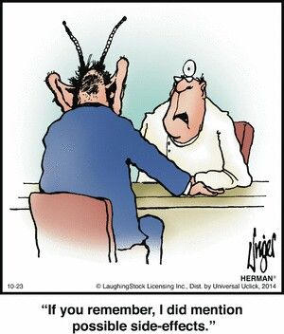

Slide 19
Emergency use is different than
Expanded Access ("compassionate use")
Emergency Use
  Life threatening situation, no other option, not time for IRB approval
  Not research*
  Does not require IRB approval (only notification)
  Requires sponsor and FDA approval
  Requires informed consent
  Only one use
Expanded Access
  Serious disease, no other satisfactory alternative (may be urgent but not emergent)
  Research*
  Requires IRB approval (or IRB chair concurrence)
  Requires sponsor and FDA approval
  Requires informed consent
  Single patient or larger population

Slide 20
Expanded Access ("compassionate" use)
The aim of the FDA Expanded Access regulations (21 CFR 312 Subpart I) is to facilitate availability of investigational new drugs to patients with serious disease when there is no satisfactory alternative therapy
Requires prospective IRB approval*
Requires informed consent
Notes:
Open Label Protocol IND
Usually uncontrolled studies, carried out to obtain additional safety data after completion phase III studies, prior to FDA approval
Treatment IND
Mechanism for providing eligible subjects with investigational drugs for the treatment of serious and life-threatening illnesses for which there are no satisfactory alternative treatments. Treatment IND may be granted after sufficient data have been collected to show that the drug "may be effective" and does not have unreasonable risks.
A sponsor may apply for a waiver of local IRB review under a treatment IND if it can be shown to be in the best interest of the subjects, and if a satisfactory alternate mechanism for assuring the protection of human subjects is available, e.g., review by a central IRB.
Parallel Track Access
permits wider access to new drugs for AIDS under a separate "expanded access" protocol that "parallels" the controlled clinical trials
Emergency IND
In an emergency situation that does not allow time for submission of an IND in the usual manner, FDA may authorize shipment of the drug for a specified use. Such authorization is usually conditioned upon the sponsor filing an appropriate application as soon as practicable. Prospective IRB review is required unless the conditions for exemption are met
Group C Treatment IND
Means for the distribution of investigational agents to oncologists for treatment of cancer under protocols outside the controlled clinical trial
Generally Phase 3 study drugs that have shown evidence of relative and reproducible efficacy
Although treatment is the primary objective and patients are not part of a clinical trial, safety and effectiveness data are collected
Because administration of Group C drugs is not done with research intent, FDA has generally granted a waiver from the IRB review requirements
20

Slide 21
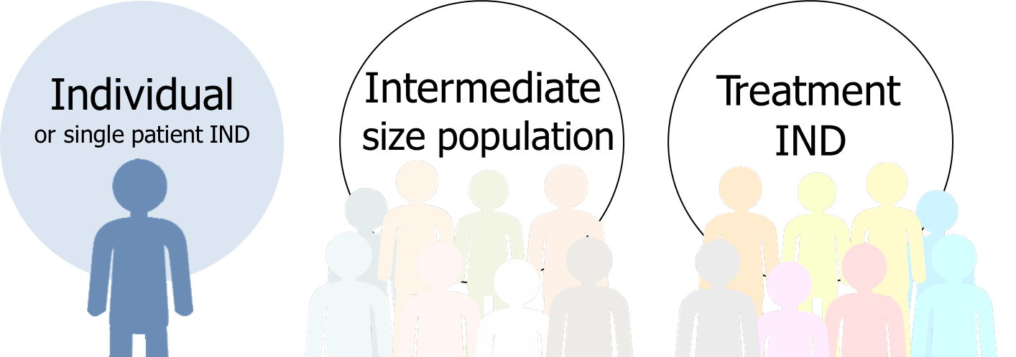
21 CFR 312 subpart I
Three distinct categories of access:

Slide 22
Individual patient EAP
(21 CFR 312.310)
Physician often takes role of sponsor/investigator
  responsible for sponsor activities such as tracking and reporting
Physician must determine probable risk from drug does not exceed that from disease
FDA must determine that the patient cannot obtain access under another type of IND
Treatment generally limited to one course (though FDA may allow ongoing therapy)

Slide 23
Individual patient EAP
(21 CFR 312.310)
*FDA allows waivers of the requirement for review and approval at a convened IRB meeting for individual patient expanded access INDs
  IRB chairperson or designated IRB member provides concurrence
  Only applies to individual patient EAPs

Slide 24
Process
Contact IRB Office
  IRBORA@unmc.edu
  (402) 559-6463

Slide 25
Process
Contact IRB Office
Complete Single Patient Expanded Access Protocol in RSS

Slide 26
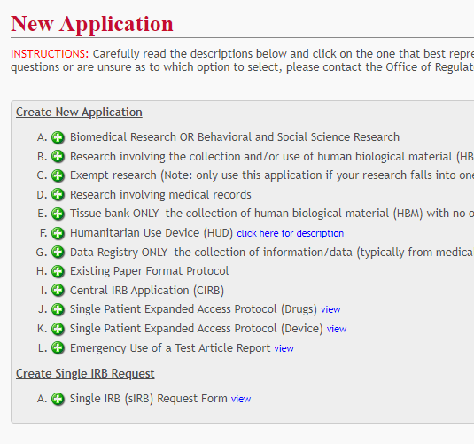

Slide 27
Process
Contact IRB Office
Complete Single Patient Expanded Access Protocol in RSS
Complete FDA form 3926
  Check box 10b if requesting waiver of the requirement for review and approval at a convened IRB meeting

Slide 28
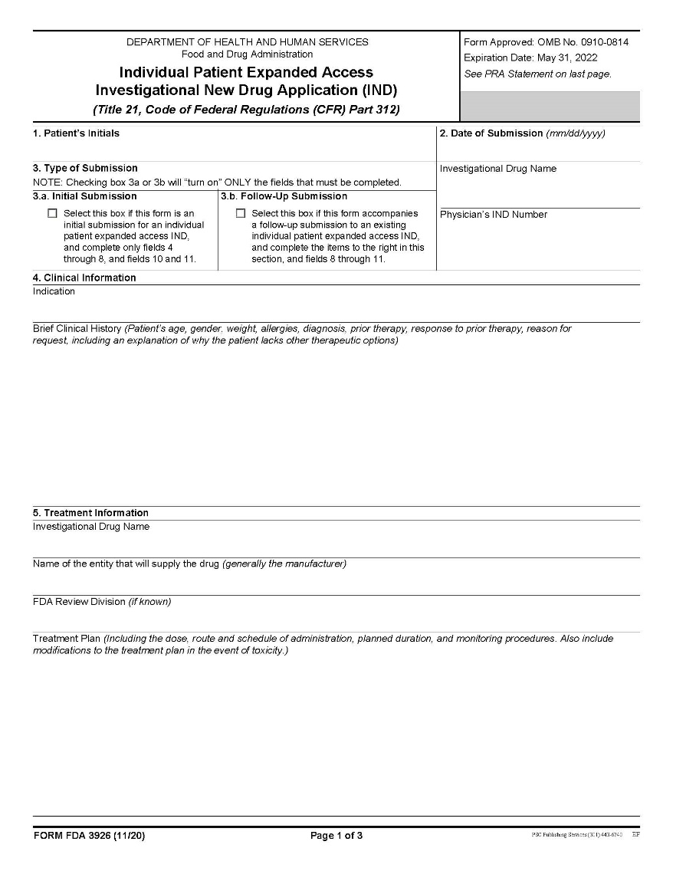
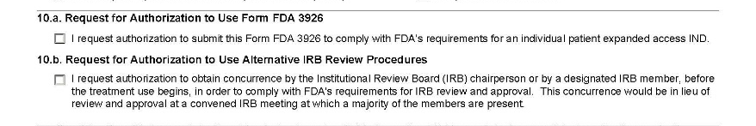
FDA 3926 (Individual Patient Expanded Access Investigational New Drug Application)

Slide 29
Process
Contact IRB Office
Complete Single Patient Expanded Access Protocol in RSS
Complete FDA form 3926
  Check box 10b if requesting waiver of the requirement for review and approval at a convened IRB meeting
Obtain written permission from the Sponsor (to use drug and to reference sponsor’s IND)

Slide 30
Process
Contact IRB Office
Complete Single Patient Expanded Access Protocol in RSS
Complete FDA form 3926
  Check box 10b if requesting waiver of the requirement for review and approval at a convened IRB meeting
Obtain written permission from the Sponsor (to use drug and to reference sponsor’s IND)
Await approval by convened IRB, or concurrence by IRB chair

Slide 31
Process
Contact IRB Office
Complete Single Patient Expanded Access Protocol in RSS
Complete FDA form 3926
  Check box 10b if requesting waiver of the requirement for review and approval at a convened IRB meeting
Obtain written permission from the Sponsor (to use drug and to reference sponsor’s IND)
Await approval by convened IRB, or concurrence by IRB chair
Obtain informed consent before using drug

Slide 32
Consent
CF must include "a statement that the study involves research, an explanation of the purposes of the research and the expected duration of the subject’s participation, a description of the procedures to be followed, and identification of any procedures which are experimental" (21 CFR 50.25(a)(1) )
  "given the compassionate nature of the request, consent documents should meet the requirements listed in 21 CFR 50.25, using plain language that is specifically aimed at 'patients' who expect direct benefit, as opposed to 'subjects' who may not expect direct benefit"

Slide 33


