Slide 1
Sponsored Programs Administration
Buzz Session
June 24, 2026
12:10 – 1:00 PM CT

Slide 2
Agenda
SPA 101
Brighter Lines – identifying G or K Team
Proposals and Grant Awards
Contracts
Ticker Review

Slide 3
Bright(er) Lines Document
A framework for assigning tasks within SPA from the proposal through award/contract review and to award set up.

Slide 4
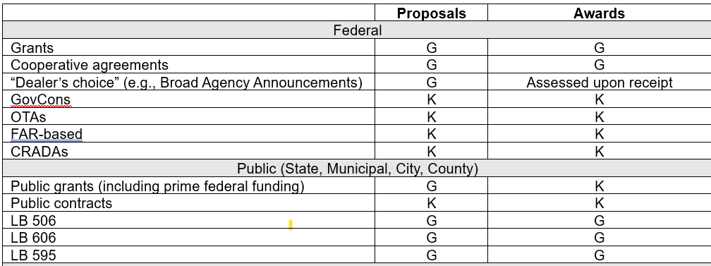
Bright(er) Lines Document
G: Grants Team K: Contracts Team

Slide 5
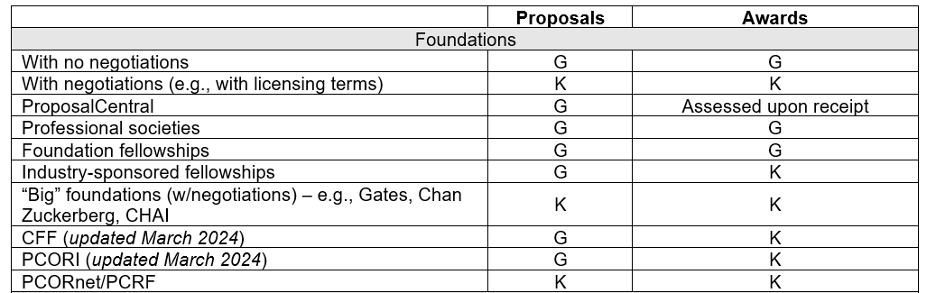
Bright(er) Lines Document
G: Grants Team K: Contracts Team

Slide 6
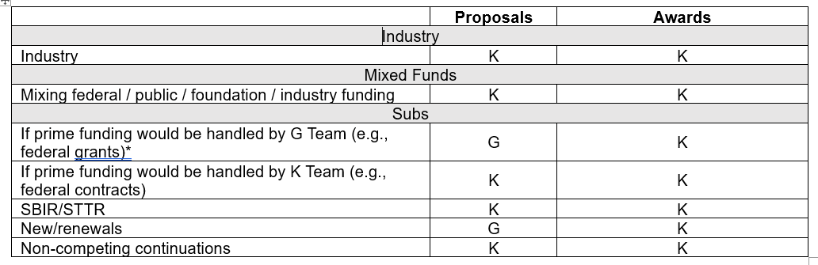
Bright(er) Lines Document
G: Grants Team K: Contracts Team

Slide 7
Proposals and Grant Awards

Slide 8
Life Cycle of a Grant
Proposal Submission
Just in Time
Award Set-up
Post Award
Closeout

Slide 9
ZOOM POLL
Are you working on any
NIH R01s for the July 5 standard due date?

Slide 10
Timely submission to SPAdmin helps us help you.
Notify SPAdmin of intent to submit at least two weeks before deadline
Submit proposal and internal forms to SPAdmin at least three business days before deadline
  PI can continue to work on abstract, research plan, and bibliography until day before deadline
Allow extra time, as needed
  Subproposals-out
  Complex program project grants
  International collaborators
  Limited submission

Slide 11
NIH | Notified SPA by | Release to SPA by | Due to Sponsor by
R01 resubmissions / renewals | Monday, June 22 | COB Tuesday, June 30 | Monday, July 6

Slide 12
Access to SPA-related Systems
Ticker
General SPA email list
eRA Commons account
Salary view (up to NIH cap)
RSS Internal Forms - Edit or view-only
Cayuse
Checklist distribution email
Research Security Training in Canvas

Slide 13
Internal forms are completed in RSS.
https://net.unmc.edu/rss/auth.php
Provides information needed for SPAdmin to review proposal
Collects institutional signatures needed for SPAdmin to submit proposal
Creates a record in SPAdmin’s database to track proposal

Slide 14
Grants.gov proposals are completed in Cayuse424.
http://unmc.cayuse424.com/
Pre-populates institutional information
Allows multiple users to work on proposal
Validates proposal against sponsor's technical requirements
SPAdmin checks for conformity with
UNMC policies
Sponsor policies
Program guidelines

Slide 15
RSS “Checklists” and “Halfsheets”
Checklist = Award amount is being changed
New project set-up
Non-competing continuations
Supplements
Renewals
Halfsheet = Award amount is not being changed
No-cost extension
Re-budgeting
Subcontract-out executed or amended

Slide 16
  Two SPAs
Sponsored Programs Administration Vice Chancelor for Research pre-award & non-financial post-award https://guides.unmc.edu/books/sponsored-programs-administration-guidebook | Sponsored Programs Accounting Business & Finance post-award https://info.unmc.edu/management/finance/spaccounting/index.html
Signs and submits applications Negotiates and signs award documents Submits progress reports Generates subaward agreements Communicates with sponsors regarding changes to project and budget Subrecipient monitoring | Sets up awards in SAP Draws down funds and/or invoices sponsor Monitors accounts for allowable costs Prepares and submits financial reports Subrecipient monitoring

Slide 17
Research Security Training for Federal Awards
https://unmc.instructure.com/enroll/XBFEN6
Current and Pending (Other) Support certification
I certify that the information provided is current, accurate, and complete. This includes, but is not limited to, information related to current, pending, and other support (both foreign and domestic) as defined in 42 U.S.C. § 6605.
In accordance with Section 10632 of the CHIPS and Science Act of 2022 (42 U.S.C. § 19232), each individual identified as a senior/key person must certify that they are not a party to a malign foreign talent recruitment program.
Research Security Training Requirement for Federal Award Personnel: In accordance with Section 10634 of the CHIPS and Science Act of 2022 (42 U.S.C. § 19234), each individual identified as a senior/key person must certify that they have completed the requisite research security training that meets the requirements specified in Item 2 of Important Notice No. 149 within 12 months prior to proposal submission.
Misrepresentations and/or omissions may be subject to prosecution and liability pursuant to, but not limited to, 18 U.S.C. §§287, 1001, 1031 and 31 U.S.C. §§3729-3733 and 3802.

Slide 18
Research Security Training for Federal Awards
https://unmc.instructure.com/enroll/XBFEN6
Biographical sketch certification
I certify that the information provided is current, accurate, and complete. This includes, but is not limited to, information related to current, pending, and other support (both foreign and domestic) as defined in 42 U.S.C. § 6605.
In accordance with Section 10632 of the CHIPS and Science Act of 2022 (42 U.S.C. § 19232), each individual identified as a senior/key person must certify that they are not a party to a malign foreign talent recruitment program.
Research Security Training Requirement for Federal Award Personnel: In accordance with Section 10634 of the CHIPS and Science Act of 2022 (42 U.S.C. § 19234), each individual identified as a senior/key person must certify that they have completed the requisite research security training that meets the requirements specified in Item 2 of Important Notice No. 149 within 12 months prior to proposal submission.
Misrepresentations and/or omissions may be subject to prosecution and liability pursuant to, but not limited to, 18 U.S.C. §§287, 1001, 1031 and 31 U.S.C. §§3729-3733 and 3802.

Slide 19
ZOOM POLL
Now that the U.S. Department of Education and the Higher Learning Commission have formally recognized the joint accreditation of UNL and UNMC, how are subawards
between campuses being handled?

Slide 20
Year End Calendar
https://unmcspa.zendesk.com/hc/en-us/articles/6324806222231-Year-End-Calendar-FY26
June 30 | All proposals submitted and awards received/fully executed should be included in FY26 reports
July 10 | Last day SPA can “import” proposals and “set up” awards to be included in FY26 reports
July 16 | SPA data locked down

Slide 21
Research Town Hall
Thursday, June 25, at noon CT
https://events.unmc.edu/event/research-town-hall-6591
Proposed rule to revise Uniform Guidance
  https://www.federalregister.gov/documents/2026/05/29/2026-10817/regulation-for-federal-financial-assistance
NIH Request for Information: Proposal to Cap the Number of Simultaneous Research Project Grants per Principal Investigator to Support More Researchers and Maximize Scientific Productivity and Innovation
  https://grants.nih.gov/grants/guide/notice-files/NOT-OD-26-086.html

Slide 22
K Team –
Contract Functions in SPA

Slide 23
Deaggregated Contracting Functions
UNeHealth – Industry Sponsored Phase I-IV Clinical Trials and Clinical Studies, CDAs, Emergency Use
UNeMed – Material Transfer Agreements, CDAs associated with business development, Licensing/Royalty Contracts
Procurement – Purchase of laboratory supplies, equipment, and other materials. Consulting/Independent Contractor Agreements
Business & Finance – Business Associate Agreements, some Testing/Service Agreements, and internal funds expended for Research

Slide 24
  Key information: SPAdmin negotiates
  Data Use/Transfer Agreements
  Confidential Disclosure Agreements
  Federal Contracts – direct contractual privity with Federal Agency (FAR-based)
    Incoming and Outgoing GovCon Subcontracts
  OTA – Other Transactional Authority
    Incoming and Outgoing Subcontracts
  Public Contracts (County, State, City, Municipality)
    Incoming and Outgoing PublicCon Subcontracts

Slide 25
  Master Clinical Trial Agreements
    Federally Funded
    Cooperative/Consortium Group Agreements
    Post market data collection
  Work Orders, Child Studies, Task Orders off Master Agreements
  Clinical Trial Agreements (stand alone)
    Federally Funded
    Cooperative Group Agreements
    Post market data collection
  Clinical Study Agreements

Slide 26
  Registry Agreements (exceptions)
  Testing agreements (exceptions)
  Master (non-clinical, non-FAR)
    Sponsored Research Agreement (SRA)
    Collaborative Research Agreement
    Technical Research Agreement
    (non-clinical, animal, bench, basic)
  Work Orders, Child Studies, Task Orders off Masters (non-clinical, FAR)

Slide 27
Stand Alone Agreements –
Sponsored Research Agreement (SRA)
Collaborative Research Agreement
Technical Research Agreement

Slide 28
SUBAWARDS
(FDP Template or Non-FDP Contract)
Incoming Sub off SBIR/STTR Prime Award (CFDA #)
Incoming Sub off Grant or Cooperative Agreement (CFDA #)
Incoming Sub off Grant (foundation or other sponsor)
Outgoing Sub off Grant or Cooperative Agreement (CFDA #)
Outgoing Sub off Grant (foundation or other sponsor)

Slide 29
Ticker Review

Slide 30
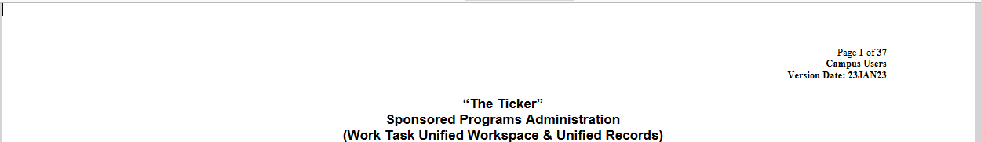
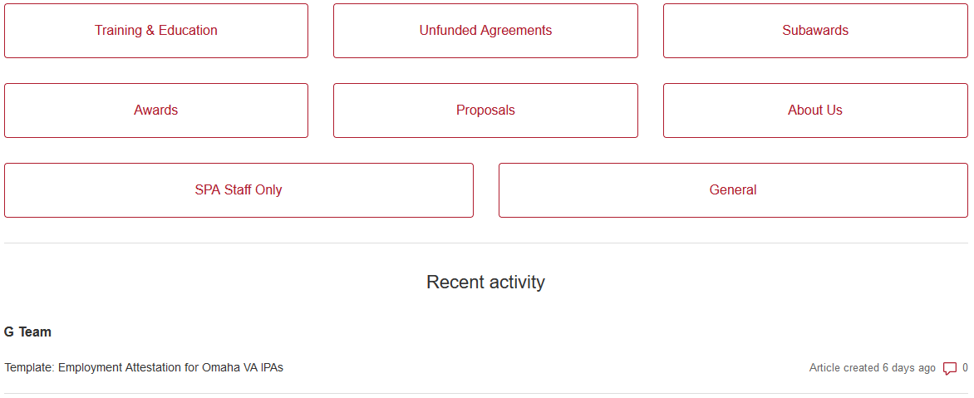
The Ticker (http://unmcspa.zendesk.com/)
Job aid:
https://unmcspa.zendesk.com/hc/en-us/articles/5993830748183-Job-Aid-The-Ticker-Campus-Users-Version-23-January-2023
Help Center:

Slide 31
The Ticker (http://unmcspa.zendesk.com/)
Advantages
Reduces “email overwhelm;” reduces the chance of “losing” a task
Unified workspace/unified record
Transparency; ability to “self-serve” a status update

Slide 32
The Ticker (http://unmcspa.zendesk.com/)
Safety net
System
  Prioritizes tasks
    Type of task
    Due date
    Time between actions
  Reporting
Human
  Analysts “sweep”
  Managers “sweep”

Slide 33
The Ticker (http://unmcspa.zendesk.com/)
How to create a ticket:
Create ticket in system
Send an email to:
support@unmcspa.zendesk.com

Slide 34
The Ticker (http://unmcspa.zendesk.com/)
For notification
ZD Status | SPA Status | Email subject line
Blue “Pending” icon | Ball is in campus’s court | ACTION REQUIRED: Ticket # 12345: Please complete the requested action(s).
Orange “Open” icon | Ball is in SPA’s court | FYI Only: Ticket # 98765: No Dept Action Needed

Slide 35
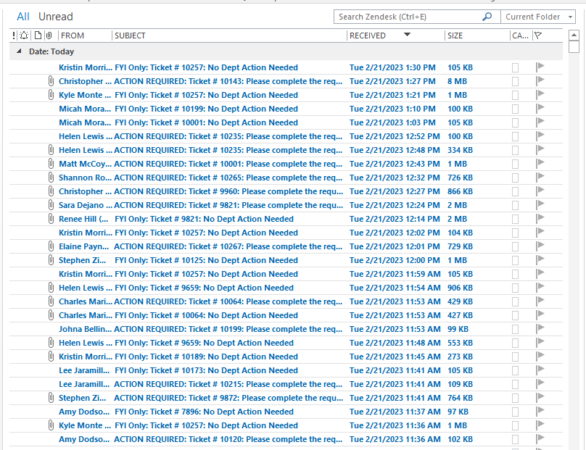
The Ticker (http://unmcspa.zendesk.com/)
Email Notifications - SPA recommends creating a Rule in Outlook to move emails to a designated folder.

Slide 36
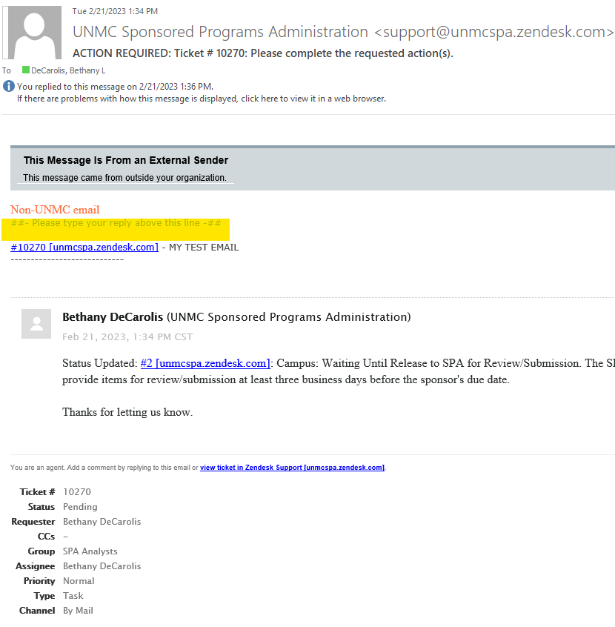
The Ticker (http://unmcspa.zendesk.com/)
To update a ticket via email

Slide 37
SPA activity - 2025 calendar year
Submissions
Grant awards
Contract negotiations (FDP template)
Contract negotiations (open)

Slide 38
SPA submissions – 2025 calendar year
Type | Count
NIH Proposal | 547
DoD Proposal (Grant) | 61
DoD Proposal (GovCon) | 5
NSF Proposal | 20
Other Federal Proposal | 40
Foundation or Association Proposal | 220
Administrative Supplement | 17
Sub Proposal | 360
SBIR/STTR Sub Proposal | 20

Slide 39
SPA submissions – 2025 calendar year
Type | Count
Post Submission Material | 81
Just In Time | 150
Progress Report | 214
Progress Report Additional Material | 90
Prior Approval Request | 163
Award Deliverable | 121
Closeout | 97
NIH Loan Repayment Program | 7
Other | 294
Total | 2,507

Slide 40
SPA grant awards – 2025 calendar year
Type | Count
Advance Account | 36
New | 126
Continuation | 176
Supplement | 49
Child Budget | 9
Re-budget | 23
No-cost Extension | 71
Non-monetary | 102
Other | 91
Total | 683

Slide 41
SPA contracts (FDP) – 2025 calendar year
In | Count
New | 63
Amendment | 194
Termination | 8
Total | 265
Out | Count
New | 87
Amendment | 158
Termination | 6
Total | 251

Slide 42
SPA contracts (open) – 2025 calendar year
Type | Count
DUA | 168
Non-FDP subaward | 111
Public contract | 111
Clinical contract | 93
GovCon | 82
Non-clinical contract | 68
Foundation award | 59

Slide 43
SPA contracts (open) – 2025 calendar year
Type | Count
CDA | 37
Internal NCE | 13
Fellowship award | 9
BHECN SubOut | 4
MOU | 4
SBIR/STTR subaward | 3
Total | 762

Slide 44
Successful management of sponsored projects requires collaboration.
Principal Investigator
Departmental Administrator
Sponsored Programs Administration
Sponsored Programs Accounting

Slide 45
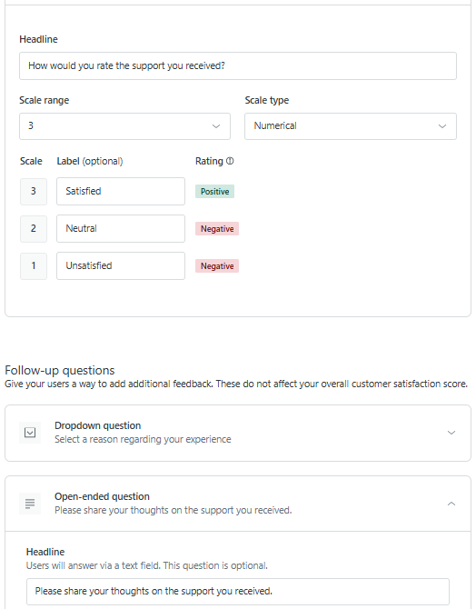

Slide 46
Questions

