Slide 1
Sponsored Programs Administration
Buzz Session
May 27, 2026
12:10 – 1:00 PM CT

Slide 2
Agenda
Subproposals – Frequently requested information
Research Security Training
NIH Updates

Slide 3
Subrecipient Letter of Intent / Subrecipient Commitment Form
When another university (Pass-Through Entity) is applying for federal funding and proposes subawarding a portion of the funding to UNMC
For example: NIH $ → PTE → UNMC

Slide 4
Subrecipient Letter of Intent / Subrecipient Commitment Form
Reducing administrative burden
380 universities participate in the Federal Demonstration Partnership’s Expanded Clearinghouse: https://fdpclearinghouse.org/
Participants agree to review each other's profiles instead of exchanging individual forms containing information in their profiles
Minor exchanges of transaction-/subaward-specific data that are allowable
If a participant requests profile information, we should push back
  Some PTEs have FDP and non-FDP versions of their form
  Some PTEs have combined forms with instructions to skip sections if FDP
If a non-participant requests profile information, we can suggest using the clearinghouse

Slide 5
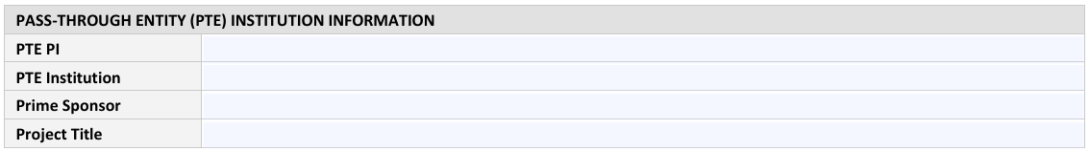
Federal Demonstration Partnership
Subrecipient Letter of Intent / Subrecipient Commitment Form

Slide 6
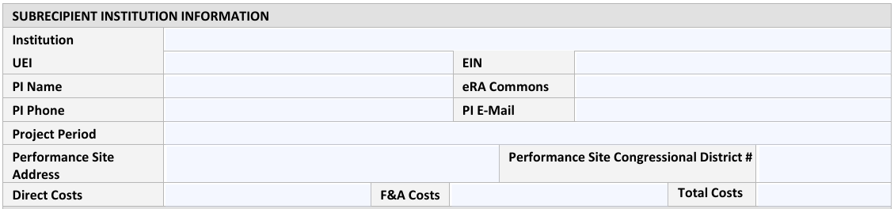
Federal Demonstration Partnership
Subrecipient Letter of Intent / Subrecipient Commitment Form

Slide 7
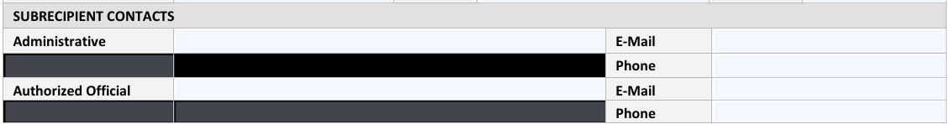
Federal Demonstration Partnership
Subrecipient Letter of Intent / Subrecipient Commitment Form

Slide 8
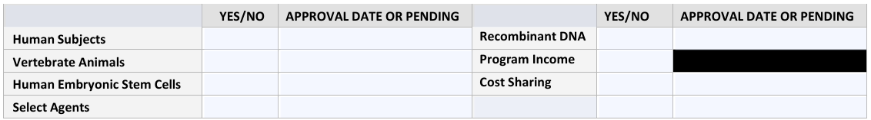
Federal Demonstration Partnership
Subrecipient Letter of Intent / Subrecipient Commitment Form

Slide 9
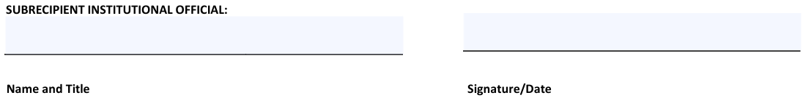
Federal Demonstration Partnership
Subrecipient Letter of Intent / Subrecipient Commitment Form

Slide 10
Federal Demonstration Partnership
Subrecipient Letter of Intent / Subrecipient Commitment Form
The Subrecipient certifies that they
Are not presently debarred, suspended, proposed for debarment, declared ineligible, or voluntarily excluded from receiving funds from any federal department or agency
Are not delinquent on any federal debt
Are in compliance with
  Drug Free Workplace Act of 1988
  U.S. Code, Section 1352, restrictions on the use of federal funds for the purpose of lobbying
  PHS policy governing Program Income
  NIH guidelines regarding human pluripotent stem cell research, transplantation of fetal tissue, recombinant DNA and human gene transfer research, and inclusion of women, children & minorities in research
Have filed
  Annually with the Office of Scientific Integrity governing Misconduct in Science
  With DHHS compliance offices certification forms governing Civil Rights (441), Handicapped Individuals (641), Sex Discrimination (639-A), Age Discrimination (680)
Have established policies in compliance with 45 CFR Part 46, Subpart A (protection of human subjects), Animal Welfare Act (PL-89-544 as amended), Health Research Exchange Act of 1985 (Public Law 99-158)

Slide 11
Federal Demonstration Partnership
Subrecipient Letter of Intent / Subrecipient Commitment Form
This proposal has been reviewed and approved by the appropriate official(s) of Subrecipient and certified to its accuracy and completeness
The appropriate programmatic and administrative personnel of Subrecipient involved in this application are aware of the prime awarding agency’s policies; agree to accept the obligation to comply with award terms, conditions, and certifications; and is prepared to establish the necessary interinstitutional agreement consistent with that policy
Any terms or rates included in the proposal described herein are not binding upon the Pass-Through Entity
All terms and conditions between the parties will be outlined in a separate formal Agreement
Institutional Official certifies to the best of their knowledge and belief that the information provided herein is true, complete, and accurate. IO is aware that the provision of false, fictitious, or fraudulent information, or the omission of any material fact, may subject them to criminal, civil, or administrative consequences including, but not limited to, violations of U.S. Code Title 18, Sections 2, 1001, 1343 and Title 31, Sections 3729-3730 and 3801-3812.

Slide 12
Frequently Requested Institutional Information
Unique Entity Identifier (UEI)
Entity Identification Number (EIN)
System for Award Management (SAM) registration
North American Industry Classification System (NAICS) code
Congressional districts
501(c)(3) determination
Rate agreement (indirect, fringe)
Audits
Guidebook | https://guides.unmc.edu/books/sponsored-programs-administration-guidebook/page/institutional-information
Help center | https://unmcspa.zendesk.com/hc/en-us/articles/1500002498481--Institutional-Information-Frequently-Requested-by-Sponsors
FDP Expanded Clearinghouse | https://fdpclearinghouse.org/organizations/279
NU Accounting | https://nebraska.edu/offices/business-finance/accounting-finance
NU FTEs | https://nebraska.edu/offices/enterprise-data-solutions/data-reports/factbook/staff/

Slide 13
Previously Requested Institutional Information
Was | Is now
Data Universal Numbering System (DUNS) number | Unique Entity Identifier (UEI)
Central Contractor Registry | System for Award Management (SAM)

Slide 14
Common Non-FDP Subrecipient Letter of Intent / Subrecipient Commitment Form elements
If Subrecipient’s scope of work includes Animal Subjects, provide
Institution’s PHS Animal Welfare Assurance number
IACUC approval date (or “pending”)

Slide 15
Common Non-FDP Subrecipient Letter of Intent / Subrecipient Commitment Form elements
Debarment, Suspension, Proposed Debarment
Subrecipient/parent entity, the PI, or any other employee or student participating in this project is not debarred, suspended, proposed for debarment, or declared ineligible for participation in federal assistance programs, federal contracts, or activities
Subrecipient/parent entity, the PI, or any other employee or student participating in this project is not presently indicted for, or otherwise criminally or civilly charged, by a government entity
Subrecipient/parent entity has not within three years preceding this offer, been convicted of or had a civil judgment rendered against them for commission of fraud or criminal offense in connection with obtaining, attempting to obtain, or performing a public (federal, state, or local) contract or subcontract; violation of federal or state antitrust statutes relating to the submission of offers; or commission of embezzlement, theft, forgery, bribery, falsification or destruction of records, making false statements, or receiving stolen property
Subrecipient/parent entity has not within three years preceding this offer, had one or more contracts terminated for default by any federal agency

Slide 16
Common Non-FDP Subrecipient Letter of Intent / Subrecipient Commitment Form elements
Conflict of Interest
Not applicable: This project is not being funded by PHS (NIH, CDC, AHRQ, etc.) or any other sponsor that has adopted the federal financial disclosure requirements (NSF, etc.)
Subrecipient Organization/Institution hereby certifies that it has an active and enforced conflict of interest policy that is consistent with the provision of 42 CFR Part 50, Subpart F, “Responsibility of Applicants for Promoting Objectivity in Research.” Subrecipient also certifies that, to the best of the Institution’s knowledge: (1) all financial disclosures will be made related to the activities that may be funded by or through a resulting agreement, and required by its conflict of interest policy; and (2) all identified conflicts of interest have or will have been have or will have been satisfactorily managed, reduced, or eliminated in accordance with subrecipient’s conflict of interest policy prior to the expenditure of any funds under any resultant agreement and with within a timely manner sufficient to enable timely FCOI reporting.
Subrecipient does not have an active and/or enforced COI policy but will have a PHS-compliant policy in place and published at the time of award
Subrecipient does not have an active and/or enforced COI policy and agrees to PTE’s policy and training

Slide 17
Common Non-FDP Subrecipient Letter of Intent / Subrecipient Commitment Form elements
FFATA Executive Compensation Exemption Certification
Our organization is not exempt from providing compensation information because:
  A. In the proceeding fiscal year, our organization received:
    (i) 80% or more of its annual gross revenues in federal awards (federal contracts, subcontracts, loans, grants, subgrants, and cooperative agreements}; AND
    (ii) $25,000,000 or more in annual gross revenues from federal awards; AND
  B. The public does not have access to information about the compensation of the senior executives of the entity through periodic reports filed under section 13(a) or 15(d) of the Securities Exchange Act of 1934 (15 U.S.C. 78m(a), 78o(d)) or section 6104 of the Internal Revenue Code of 1986
Our organization is exempt from reporting compensation

Slide 18
Common Non-FDP Subrecipient Letter of Intent / Subrecipient Commitment Form elements
Audit Status
Subrecipient was required to conduct an annual audit in accordance with the Uniform Guidance Subpart F, Audit Requirements for the most recent Audit year
  Most recent fiscal year audit completed?
  Were there any audit findings reported?
    If so, include URL or attach a copy
Subrecipient does not receive an annual audit in accordance with Uniform Guidance requirements. Subrecipient is:
  Nonprofit entity under federal funding threshold
  Foreign entity
  For-profit entity
  Government

Slide 19
Common Non-FDP Subrecipient Letter of Intent / Subrecipient Commitment Form elements
Audit Status
No material weaknesses, no material instances of noncompliance with federal laws or regulations, no reportable conditions, no findings, and there are no unresolved prior year findings related to any subaward(s) from PTE
There are material weaknesses, material instances of noncompliance with federal laws or regulations, reportable conditions, findings, or unresolved prior year findings related to subaward(s) from PTE

Slide 20
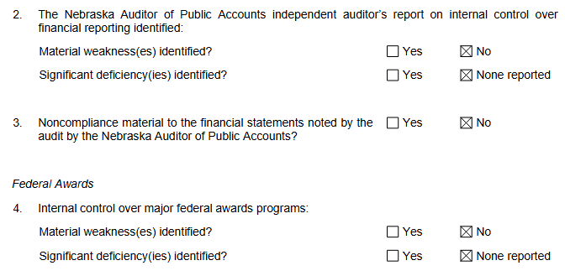
Common Non-FDP Subrecipient Letter of Intent / Subrecipient Commitment Form elements
University of Nebraska Single Audit Reports for Year Ended June 30, 2025
https://nebraska.edu/offices/business-finance/accounting-finance#docaccess-2ce2e8a489a1d70596ae435fa0a15296

Slide 21
Common Non-FDP Subrecipient Letter of Intent / Subrecipient Commitment Form elements
Fiscal Responsibility
Subrecipient certifies that
Its financial system is in accordance with generally accepted accounting principle and has the capability to identify, in its accounts, all federal awards received and expended and the federal programs under which they were received
It maintains internal controls to assure that it is managing federal awards in compliance with applicable laws, regulations, and the provisions of contracts or grants
It complies with applicable laws and regulations
It can prepare appropriate financial statements, including the schedule of expenditures of federal awards
Has a procurement system that allows for free and open competition and eliminates or reduces conflict of interest in the procurement process
Has a financial management system that provides for the control and accountability of project funds, property, and other assets

Slide 22
Common Non-FDP Subrecipient Letter of Intent / Subrecipient Commitment Form elements
Ethics in Research Training
Subrecipient organization/institution will ensure that all undergraduates, graduate students, and postdoctoral researchers who will be support by this NSF proposal will be trained on the oversight of the responsible and ethical conduct of research
Not applicable because this project is not being funded by NSF

Slide 23
Common Non-FDP Subrecipient Letter of Intent / Subrecipient Commitment Form elements
Subrecipient is in compliance with all federal rules and regulations.

Slide 24
Common Non-FDP Subrecipient Letter of Intent / Subrecipient Commitment Form elements
Certification Regarding Malign Foreign Talent Recruitment Programs - DOE, NASA, NIH, NSF only
Subrecipient’s Authorized Official certifies all covered individuals* participating on this project have been made aware of and have certified they are not a party to a Malign Foreign Talent Recruitment Program, in accordance with Section 10632(a) of the CHIPS and Science Act of 2022
*The CHIPS and Science Act of 2022 defines a ”covered individual” as an individual who (A) contributes in a substantive, meaningful way to the scientific development or execution of a research and development project proposed to be carried out with a research and development award from a Federal research agency; and (B) is designated as a covered individual by the Federal research agency concerned.

Slide 25
Common Non-FDP Subrecipient Letter of Intent / Subrecipient Commitment Form elements
Certification Regarding Research Security Training – DOE, NSF, USDA, and NIH only
Subrecipient’s Authorized Official certifies all covered individuals* participating on this project have completed research security training consistent in accordance with Section 10634 of the CHIPS and Science Act of 2022
*The CHIPS and Science Act of 2022 defines a ”covered individual” as an individual who (A) contributes in a substantive, meaningful way to the scientific development or execution of a research and development project proposed to be carried out with a research and development award from a Federal research agency; and (B) is designated as a covered individual by the Federal research agency concerned.

Slide 26
Research Security Training
Existing
  Information Security Awareness
  Conflict of Interest
New
  Research Security course in Canvas: https://unmc.instructure.com/enroll/XBFEN6

Slide 27
Research Security Training
Research Security
  Defining Research Security
  The Importance of Safeguarding Research
  Research Data Oversight
  Federal Drivers of Research Security
  Disclosure Responsibilities (COI/COC + Other Support)
  International Collaboration & Foreign Interference
  Real‑World Examples (Talent Programs & IP Concerns)
  The Value of International Collaboration
Export Control
  Understanding the Purpose of Export Controls
  When Export Controls Might Apply
  Primary Regulatory Agencies
  The Fundamental Research Exclusion (FRE)
  Defining an Export & Deemed Export
  Case Scenario: International Engagement
  Module Wrap‑Up & Where to Get Help
Mentoring & Responsible Use of Funds
  Mentor and Mentee Relationships
  Responsibilities in Mentoring
  Responsible Use of Funds (Federal Awards)
  Resources & Contacts
Attestation

Slide 28

NIH Common Forms: Tips and Tricks
REMINDER – NIH is now enforcing the use of the Common Forms for Biographical Sketch and Current/Pending (Other) Support
NOT-OD-26-079: Announcement of Upcoming System Enforcement of Common Forms and End of NIHs Leniency Period
Senior/Key Personnel must create the Common Forms in SciENcv to produce digitally certified PDFs
Senior/Key Personnel must also obtain an ORCID ID and link the ORCID ID to their era Commons account in their Personal Profile (PPF)

Slide 29
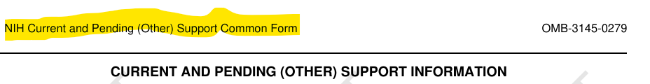
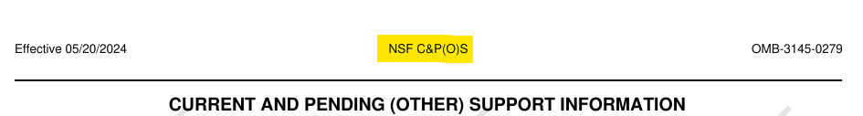
NIH Common Forms: Tips and Tricks
Ensure the correct Common Form is being used for the sponsoring federal agency

Slide 30
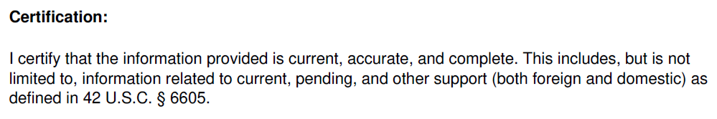
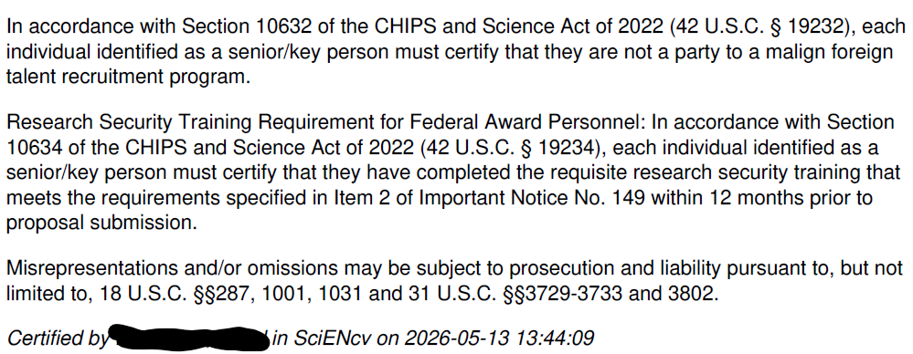
NIH Common Forms: Tips and Tricks
2. Make sure the form is certified.

Slide 31
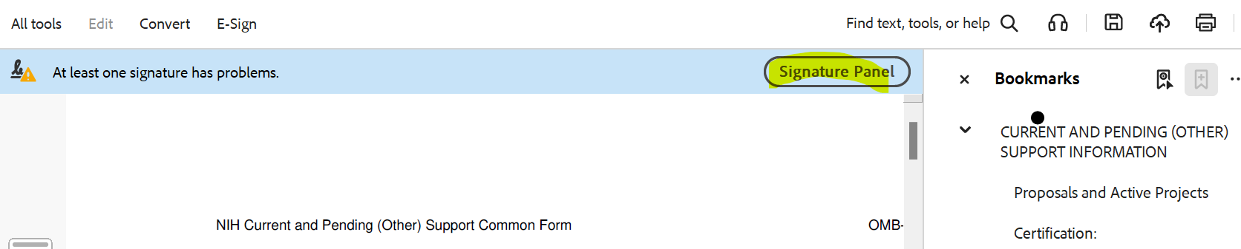
NIH Common Forms: Tips and Tricks
3. The PDF document should have a “Signature Panel.” Common Forms should NOT be flattened in order to retain the necessary certification properties.

Slide 32
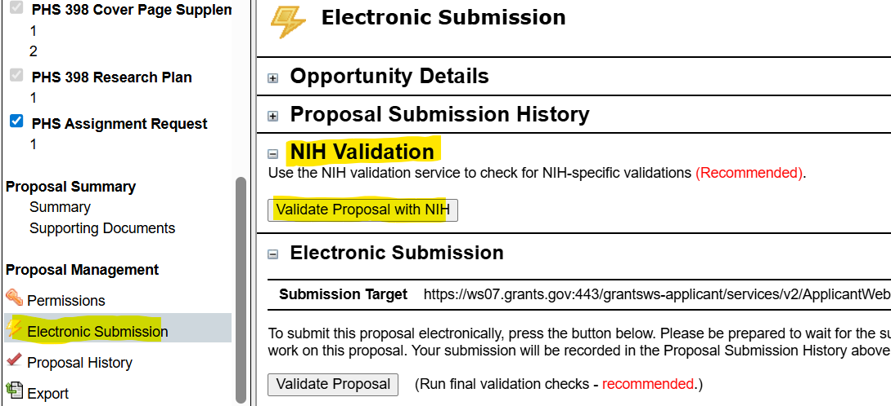
NIH Common Forms: Tips and Tricks
4. Run NIH Validations in Cayuse
  The NIH Validation should indicate whether or not the ORCID ID is linked to era Commons profile, and whether or not the correct form is used
Notes:
ORCID ID linked to Sciencv form – AND linked to era Commons Profile

