Slide 1
Sponsored Programs Administration
Buzz Session – International Project Considerations
July 22, 2026
12:10 PM – 1:00 PM

Slide 2
Export Control Office Overview
Sam Padilla, Trevor Carritt, and Stephen Asante-Addae
Export Control Office

Slide 3
Export Office Team
Office email: exportcontrol@unmc.edu
UNMC Export Control Website
Sam Padilla, University of Nebraska Export Control Director
(samuel.padilla@unmc.edu)
Trevor Carritt, UNMC/UNO Export Control Manager - Shipping
(tcarritt@unmc.edu)
Stephen Asante-Addae, UNMC Export Control Coordinator
(sasanteaddae@unmc.edu)

Slide 4
What is Export Control?
Definition:
  Export controls are U.S. laws and regulations that govern the transfer of:
    Technology and technical data
    Software
    Equipment
    Biological materials
When Export Controls Apply:
  International research collaborations
  International shipments
  Data sharing
  Access to controlled technology by foreign nationals
  International travel
Notes:
Export controls are laws and regulations that govern the transfer of certain technologies, technical data, software, equipment, and biological materials to foreign persons or countries- or even with certain foreign nationals here in the U.S. They may apply to research collaborations with foreign persons, international data sharing, international shipments, and access to controlled technologies by international researchers. These regulations exist to protect national security, support U.S. foreign policy, and ensure compliance with federal laws.

Slide 5
Export Control Office
Our Goal:
  Assist faculty, staff, project coordinators, and shippers
  Review international research activities
  Help manage regulatory risk
  Protect sensitive technologies
  Safeguard research funding and institutional compliance
Notes:
Our office exists to help UNMC navigate these requirements while supporting our teaching, research, and outreach missions. Our goal is not to create barriers, but rather to help faculty and staff conduct their work safely, efficiently, and in compliance with federal regulations and university policies.
Some of the services we provide include:
Reviewing matters such as international shipments of equipment, materials, software, and biological materials, to determine whether licenses or other requirements apply.
Assisting researchers with export control requirements in sponsored research, including identifying projects that may be subject to export control restrictions.
Screening international collaborators, visitors, vendors, and other parties against federal restricted party lists. For this, we work with PIs and coordinators, as well as the Office of Global Engagement.
Providing guidance on international travel, including when university-owned laptops, equipment, or controlled technology are involved. You typically notice our office’s involvement with forms such as the international travel checklist on NuRamp.
Helping departments understand U.S. export control regulations when working with certain countries or organizations.
Offering training and educational resources, such as CITI trainings, so faculty and staff understand when export controls may apply to their work.

Slide 6
How We Help
Research & Project Support
  Review international research activities
  Identify export control requirements in sponsored research
  Determine when licenses or additional reviews are needed
  Conduct restricted party screenings
  Coordinate with UNMC’s Office of Global Engagement
International Shipping
Review shipments of:
  Equipment
  Biological materials
  Software
  Research materials
Notes:
Some of the services we provide include:
Reviewing matters such as international shipments of equipment, materials, software, and biological materials, to determine whether licenses or other requirements apply.
Assisting researchers with export control requirements in sponsored research, including identifying projects that may be subject to export control restrictions.
Screening international collaborators, visitors, vendors, and other parties against federal restricted party lists. For this, we work with PIs and coordinators, as well as the Office of Global Engagement.

Slide 7
How We Help
Travel & Education
  Guidance for international travel
  Review university-owned equipment taken abroad
  Provide export control training and educational resources
Notes:
Our office also assists in:
Providing guidance on international travel, including when university-owned laptops, equipment, or controlled technology are involved. You typically notice our office’s involvement with forms such as the international travel checklist on NuRamp.
Helping departments understand U.S. export control regulations when working with certain countries or organizations.
Offering training and educational resources, such as CITI trainings, so faculty and staff understand when export controls may apply to their work.

Slide 8
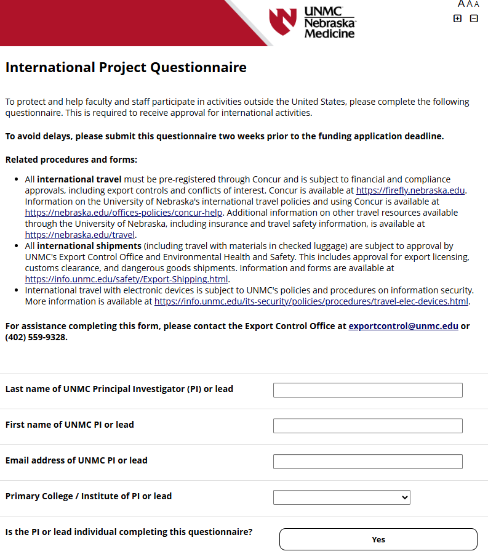
International Project Questionnaires
What We Review:
Who is involved?
Where is the project taking place?
What is being shared?
How will it be shared?
Who is funding the project?
Are restricted parties involved?
Notes:
The UNMC International Project Questionnaires or IPQs are used to identify potential export control concerns before an international project begins. We review various information such as project protocols, collaborating institutions, travel involved, and the data, biological materials, or other information being shared to determine whether the project can move forward or whether additional reviews, licenses, or safeguards are needed to proceed. Our office reviews questionnaires mainly through the avenues of REDCap and RSS.
The questionnaire asks questions such as:
Who is involved? Are there international collaborators, visiting scholars, or foreign institutions?
Where is the project taking place? Some countries are subject to U.S. sanctions or other restrictions and may require additional approval such as approval from the president’s office.
What is being shared? This could include research data, software, biological materials, equipment, or technical information.
How is it being shared? For example, through shipping, email, cloud storage, remote access, or travel.
Who is funding the project? Certain funding sources may impose restrictions or require additional compliance reviews.
Are there restricted parties involved? Our office reviews whether we are collaborating with individuals or organizations on U.S. government restricted party lists.
Why is this important?
The questionnaire helps determine whether the project could involve:
Export-controlled technology or technical data
International sanctions
Export licensing requirements; or
Additional compliance measures before work can begin.
How this differs from an IRB questionnaire
IRB questionnaires are reviewed by our office, then communicated to the IRB once a determination has been given. This differs from an international project questionnaire, where our determination is shared with SPA or UNeHealth contact, if applicable. IRB ask as for a lot of the same information, but targeted for IRB oversight, funded or not. General IRB project, clinical studies.
Some there may not be funding. If IRB oversight at all, otherwise.

Slide 9
Countries of Concern
Foreign country of concern – any country identified as a foreign adversary of the United States or any country subject to economic sanctions by the United States
Executive Memo 25 – travel to high-risk destinations
Executive Memo 36 – outside professional activities
Executive Memo 46 – institutional activities

Slide 10
Countries of Concern
Distinction between institutional and outside professional activities may not always be clear
Both types of activities disclosed via COI-SMART
Activities that involve a country of concern require provost approval
Contact exportcontrol@unmc.edu for assistance
Approval timelines depend on complexity and level of risk (typically 2-6 weeks)

Slide 11
Countries of Concern
Waiver process:
Collect information:
  What is the activity?
  Who is involved?
  Why does it need to happen?
  Will money be exchanged?
Draft approval request (assistance available from Export Control)
Submit to vice chancellor
  Research/clinical trials: VC-Research
  Travel and everything else: VC-Academic Affairs
Sumit to chancellor
Submit to provost
Appeals submitted to president

Slide 12
Countries of Concern
Must be approved:
  Research collaborations (including clinical trials)
  Purchasing
  Joint publications
  Advising students (outside of UNMC)
  Short-term visitors (clinical observers, workshops, non-HR visitors)
  Travel (also requires safety waiver; applies to $0 trips)
  Shipping/exporting
Approval not required:
  Admissions
  Advising NU students
  Research collaborations in non-concern countries
  Hiring (faculty, lab techs, postdocs)
  Export control approval may still be required in some circumstances.
Notes:
These items refer to activities that involve a country of concern in some capacity. Activities that require provost approval include:
Research collaborations (including clinical trials) where a collaborator, sponsor, study site, or service provider is located in a country of concern, especially if data or specimens will be leaving the US.
Purchases from vendors located in or controlled by an entity located in a country of concern.
Joint publications with someone located in or affiliated with an institution located in a country of concern.
Serving on a dissertation committee or similarly advising students at an institution located in a country of concern.
Hosting visitors from a country of concern.
Traveling to a country of concern for any purpose, including conducting or presenting research, attending a workshop or conference, or recruitment. Note that traveling to a country of concern also constitutes traveling to a high-risk destination, so it is also necessary to obtain a safety waiver.
Shipping or otherwise exporting any items or data to a recipient in a country of concern.
Approval is typically not required in the following circumstances:
Admissions and hiring decisions.
Advising students who have been admitted to UNMC or another NU campus.
Research collaborations (including clinical trials) where none of the collaborators, sponsors, study sites, and service providers are located in a country of concern. This exception still applies when the collaboration is with a citizen of a country of concern who is located in a non-concern country and affiliated with an institution in that country.

Slide 13
NIH Foreign Component
NOT-OD-26-084: Reminder Definition of Foreign Components
Foreign Component Definition: The performance of any significant scientific element or segment of a project outside of the United States, either by the recipient or by a researcher employed by a foreign organization, whether or not grant funds are expended.

Slide 14
NIH Foreign Component
NOT-OD-26-084: Reminder Definition of Foreign Components
Foreign Component Examples
Involvement of human or animal subjects at a foreign site | Collaborations with investigators at a foreign site anticipated to result in co-authorship
Extensive foreign travel by recipient for data collection, surveying, sampling etc. | Use of facilities or instrumentation at a foreign site
Any activity that may have an impact on US foreign policy through involvement in the affairs or environment of a foreign country | Receipt of financial support or resources from a foreign entity

Slide 15
NIH Foreign Component
NOT-OD-26-084: Reminder Definition of Foreign Components
Most instances of co-authorship represent a foreign component.
PRAM examples – NIH requesting clarification when co-author is from foreign institution
NOFO must allow foreign components

Slide 16
NIH Foreign Components: Application Stage
Collaborative International Research Project (PF5) - NIH will make domestic prime awards with independent foreign awards that are linked to the prime https://grants.nih.gov/funding/activity-codes/PF5
VS:
Consultants and Nonmonetary Foreign Collaborations

Slide 17
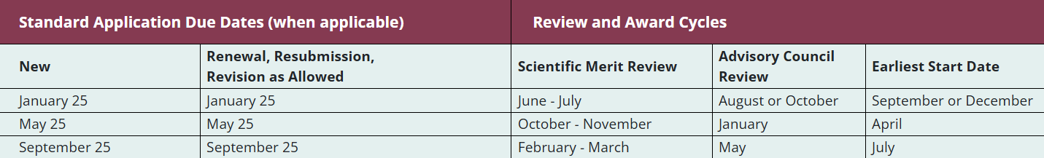
NIH Collaborative International Research Project (PF5)
PA-26-002: NIH Collaborative International Research Project (Parent PF5 Clinical Trial Optional)
Multi-component application structure
Overall Component – Broad overview of proposal including why international collaboration is needed to address the goals, and how it will be coordinated with international sites
Research Project Component – Domestic applicant – Details the significance, innovation, and approach to allow an assessment on the technical and scientific merit
International Project Component – Describes the scope of work, unique attributes, and contributions of the foreign organization(s).
Optional - Cores and/or Institutional Career Development and Training components (P01s, P50s, K12s)

Slide 18
NIH Collaborative International Research Project (PF5)
PA-26-002: NIH Collaborative International Research Project (Parent PF5 Clinical Trial Optional)
Letters of Support – For each international organization, a Letter of Support from the organization’s authorized official is required
Indicate their understanding that if funded, the foreign organization will be a recipient for the disaggregated award and will have all necessary registrations completed prior to award (UEI, Sam.gov)
Subproposal documents (LOI, SOW, Budget, Budget Justification) are not required to be collected
Budget Considerations
International Organization Indirect Cost Rate = 8%
UNMC will not collect indirect costs off the international project
RSS Budget – Use “Exempt” category to show the international project cost. Budget will be revised upon award.

Slide 19
NIH Grants Policy Statement: Collaborative International Research Award Structure 16.8 Collaborative International Research Awards
Application Review and Award
Undergo peer review as a single integrated application
Domestic applicant and international organization will receive separate NIH awards and PMS subaccounts for financial tracking
JIT process for both the PF5/UF5 domestic organization and RF2/UL2 foreign organization
Administrative Requirements
RPPRs – Both domestic org. and foreign org. must submit separate RPPRs, but information does not need to be duplicated (more to come!)
FFR – International org. will be required to submit separate FFR
Rebudgeting of funds between the domestic and international orgs. is not permitted
Carryforward – Collaborative International Research Awards do not have automatic carryover (unless specified in NOFO)
Closeout – Both domestic and foreign orgs. submit closeout docs.

Slide 20
NIH Grants Policy Statement: Collaborative International Research Award Structure 16.8 Collaborative International Research Awards
Administrative Requirements (Continued)
Written Agreement – Prior to award, the domestic and foreign institutions must establish a written agreement detailing the following at minimum:
Roles and responsibilities of key personnel
Procedures for monitoring/directing research
Procedures for managing disputes
Provision addressing ownership and disposition of data
Expectations of authorship and co-authorship
Provision requiring the foreign organization to provide access to copies of all lab notebooks, all data, and documentation that supports the research outcomes no less than annually

Slide 21
Adding a Foreign Component to an Existing NIH Award 8.1.2 Prior Approval Requirements
Per NIH Grants Policy Statement 8.1.2.10
Adding a non-monetary foreign component under a grant to a domestic or foreign organization requires NIH prior approval. NIH will not accept nor approve requests to add a foreign subaward to an ongoing project.
NIH Foreign Subaward Policy FAQs: https://grants.nih.gov/faqs#/Foreign-Subaward-Policy
PF5 Video: https://www.youtube.com/watch?v=qv4QjVt4fho

Slide 22
Ever-changing compliance landscape
Different agencies have implemented rules differently
May include restrictions, certifications, and reporting
Examples
  Entities identified as Chinese Military Companies Operating in the United States in accordance with Section 1260H of the National Defense Authorization Act for Fiscal Year 2021
  Malign Foreign Talent Recruitment Program Certification
  Foreign Countries of Concern in accordance of Section 10339B of the CHIPS and Science Act of 2022
If you're submitting a proposal with an international collaboration
https://guides.unmc.edu/books/sponsored-programs-administration-guidebook/page/internal-deadlines
Notify SPAdmin at least one month before the sponsor’s deadline
Provide a copy and route ADIS Internal Forms at least one week before the sponsor’s deadline

Slide 23
Closing Slide [do not remove]

