Slide 1
Sponsored Programs Administration
Buzz Session
September 23, 2026
12:10 – 1:00 PM CT

Slide 2
  Agenda
  Advance Accounts
  Q&A

Slide 3
Advance Accounts: Compliance issues
Charge expenses to the correct account
Close projects in a timely manner

Slide 4
Advance Accounts: Compliance issues
Charge expenses to the correct account
Auditors consider an excessive number of cost transfers, particularly long-after the original transactions occurred, to be an indication of poor internal control

Slide 5
Personnel
Funding Changes done in a timely manner
No need to answer the 2 or 4 questions because of delays in set up
Advance account to Grant funding changes – easily explained
Competitive AA – set up as a 37
Non-competitive AA – set up as the next year of a 34, 35 or 36
  Solves
    Delays in subcontracts being issued
    Salary remaining on accounts simply because the WBS# isn’t set up

Slide 6
Advance Accounts: Compliance issues
Close projects in a timely manner
Uniform Guidance requires that projects be closed within 120 days of end date
Sponsored Programs Accounting locks accounts 30 days after end date

Slide 7
Advance Accounts: Purpose
To create a WBS # before an award is ready to be set up
Pre-award spending
Delays in receiving award document
Delays in setting up award
  Because of
    Cuts in Awards
    Changes in personnel
    Changes in allocation to children accounts
    Waiting for signatures

Slide 8
Advance Accounts: Purpose
Pre-award spending
UNMC may – at our own risk and without prior approval – incur costs up to 90 days before the start date if such costs
  Are necessary to conduct the project
  Would be allowable under the grant, if awarded

Slide 9
Advance Accounts: Purpose
Delays in receiving award document
Subcontracts-in
NE DHHS

Slide 10
Advance Accounts: Purpose
Delays in setting up award
Award cut, internal budget needs to be modified
IRB or IACUC protocol not approved
Subaward agreement needs to be negotiated
Subaward agreement needs to be signed by both parties

Slide 11
Advance Accounts: WBS #
For new WBS #
If WBS # will change

Slide 12
Advance Accounts: WBS #
If WBS # will change: Digits 8-13
(e.g., 36-1209-3001-001)
New document number
  Competitive cycle (renewal)
  Administrative action moving to a different Payment Management System subaccount

Slide 13
Advance Accounts: WBS #
If WBS # will change: Digits 11-13
(e.g., 36-1209-3001-001)
If an annual financial report is required
If carry-forward is not automatic

Slide 14
Advance Accounts: “Non-advance” accounts
 | Advance Account | Award
Federal letter of credit – Competing (new or renewal) | 37- | 34-
Federal letter of credit – Non-competing (continuation) | 34-
Federal non-letter of credit | 35-
Non-federal | 36-

Slide 15
Advance Accounts: Process
Consider – If no award is made or charges are disallowed, department required to cover costs
Request - in RSS
Monitor
  Initially set up for 90 days
  Can be extended in 30-day increments
Close Advance Account
  Convert to “non-advance,” or
  Transfer expenses to alternate cost center

Slide 16
Advance Accounts: Roles and Responsibilities
Dept. admin. | Initiates AA request in RSS
PI | Has reasonable assurance from sponsor that award will be made Certifies that anticipated expenses are necessary for project’s efficient and timely performance
Dean / Chair | Accepts financial responsibility for any charges if no award is made or charges are disallowed
SPAdmin, SPAcctng | Set up and monitor advance account

Slide 17
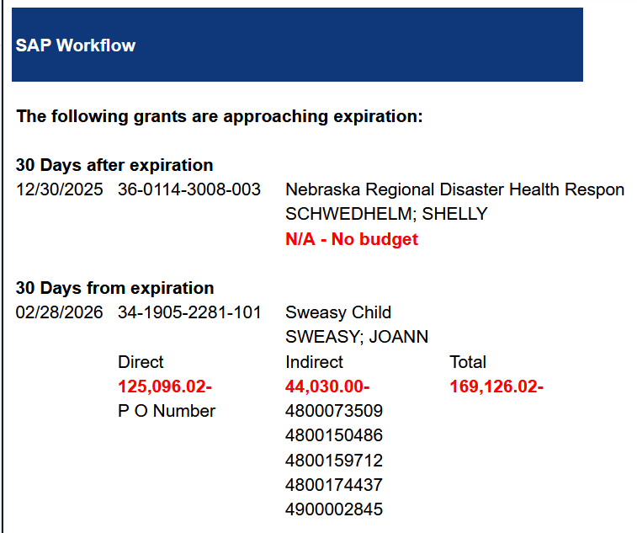

Slide 18
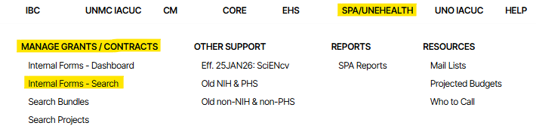
  RSS Advance Account Guide
Log into RSS: https://net.unmc.edu/rss/home.php
Click SPA/UNeHealth | Manage Grants/Contracts | Internal Forms – Search

Slide 19
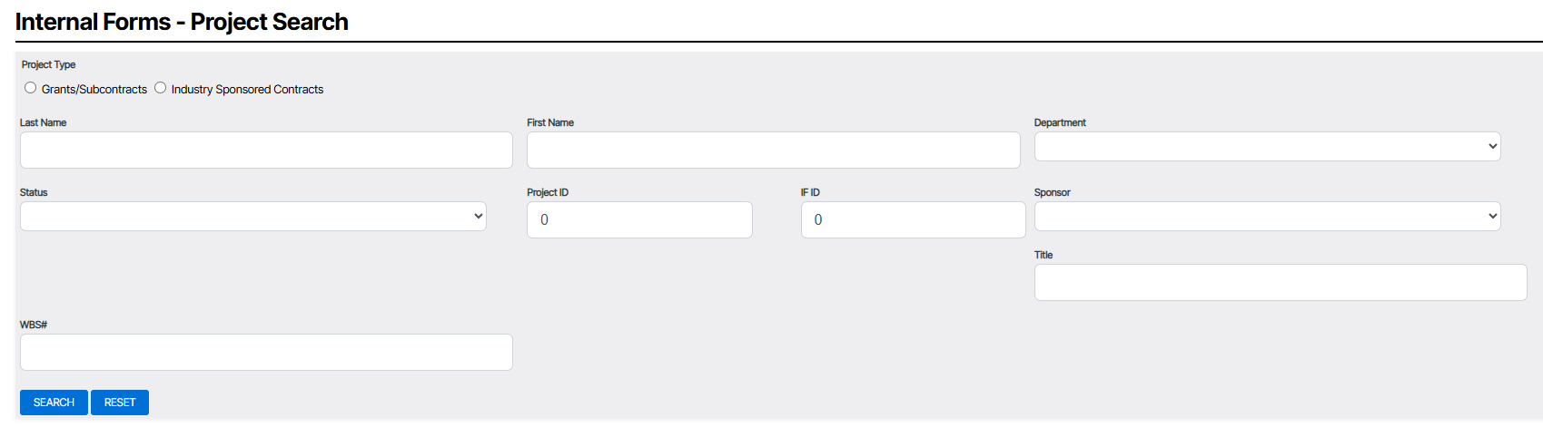
  RSS Advance Account Guide
Search for your project

Slide 20
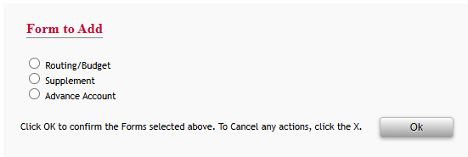
  RSS Advance Account Guide
Click the green plus sign
Select Advance Account
Click OK

Slide 21
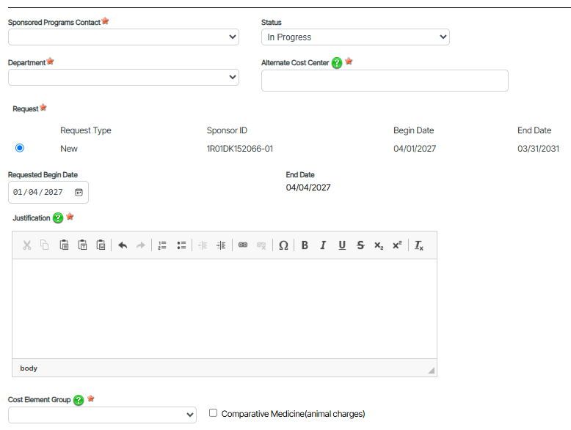

Slide 22
  RSS Advance Account Guide
  Your Alternate Cost Center (a 31-, 33-, or 37-)
    If funding isn’t awarded, you will move any expenses onto this account
  Requested Begin Date
    It cannot be later than the Begin Date of the proposal selected
    A 90-day pre-award spending period is automatically calculated but can be overridden

Slide 23
Advance Accounts: Cost Element Groups
WFEDERAL | All cost elements considered allowable by UG
WNOAID | All salary, benefit, operating expense, supply, travel expense & Equipment cost elements. No Aid (56XXXX).
WNOEQ-AID | All salary, benefit, operating expense, supply & travel expense cost elements. No equipment (55XXXX), no aid (56XXXX).
WNOEQUIP | All salary, benefit, operating expense, supply & travel expense and aid cost elements. No equipment (55XXXX).
WNOFORTRAV | All cost elements except Foreign Travel.
WNOTRAVEL | All cost elements except Travel.
WSANDW | All Salaries and Wages cost elements.
52XXXX | Operating Expenses/Services - only cost elements that begin with 52.
53XXXX | Operating Supplies only - cost elements that begin with 53.
52OPDETAIL | Total Operating Expenses & Supplies - all cost elements that begin with 52 & 53.
54TOTAL | All Travel - Domestic and Foreign.
55XXXX | Capital Outlay – equipment.
WAID | Government Aid - cost elements that begin with 56.
Comparative Medicine ( Y | N )

Slide 24
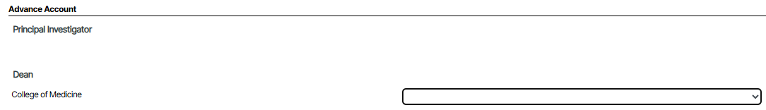
  RSS Advance Account Guide
Click Next
Select the people who will sign for your unit

Slide 25
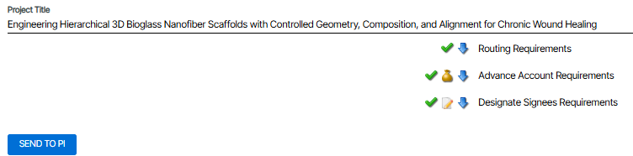
  RSS Advance Account Guide
Click Next
Click Send to PI

Slide 26

Q&A
https://guides.unmc.edu/books/sponsored-programs-administration-guidebook/page/training

